Slide 1
EE969-469:
Time Frequency Analysis
Dr Carmine Clemente carmine.clemente@strath.ac.uk

Slide 2
Time Frequency Distributions
Signal Processing
Time-domain techniques
Freq.-domain techniques
TF domain techniques
Filters
Fourier T.
Non/Stationary Signals
Stationary Signals
Time-Frequency
Distributions
STFT
Spectrogram
WVD
SPWVD
Cepstrogram
Applications
Signal Analysis
Detection,
Classification
BME / NDE
Other…

Slide 3
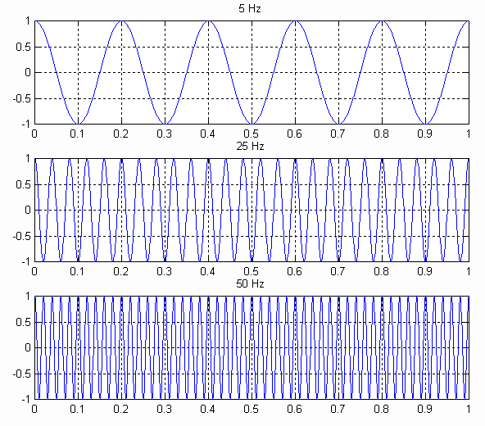



Time-Frequency Distributions
FT: At work

Slide 4
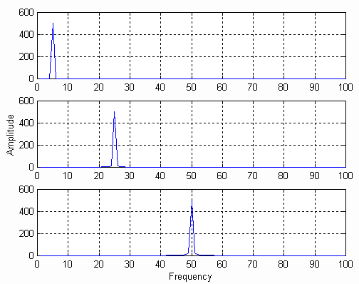






FT At Work
F
F
F

Slide 5
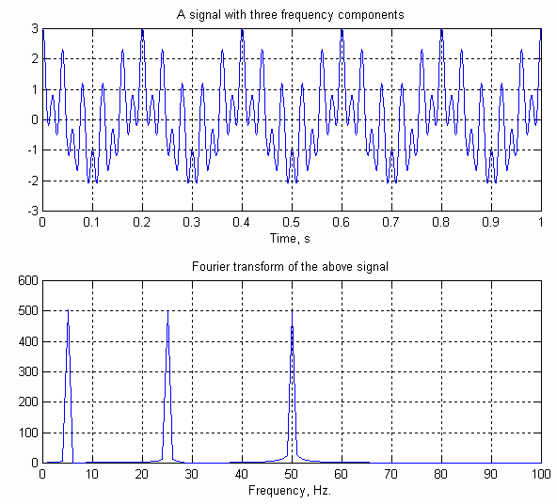
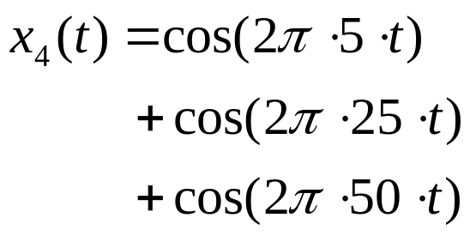


FT At Work
F

Slide 6
Stationary and Non-stationary Signals
FT identifies all spectral components present in the signal, however it does not provide any information regarding the temporal (time) localization of these components. Why?
Stationary signals consist of spectral components that do not change in time
  all spectral components exist at all times
  no need to know any time information
  FT works well for stationary signals
However, non-stationary signals consists of time varying spectral components
  How do we find out which spectral component appears when?
  FT only provides what spectral components exist , not where in time they are located.
  Need some other ways to determine time localization of spectral components

Slide 7
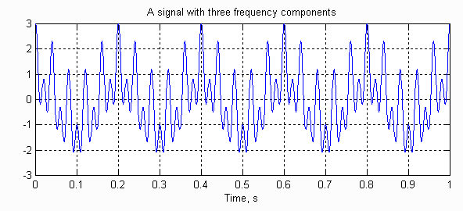
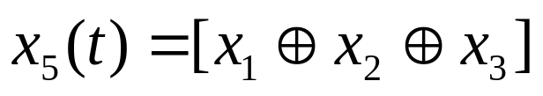
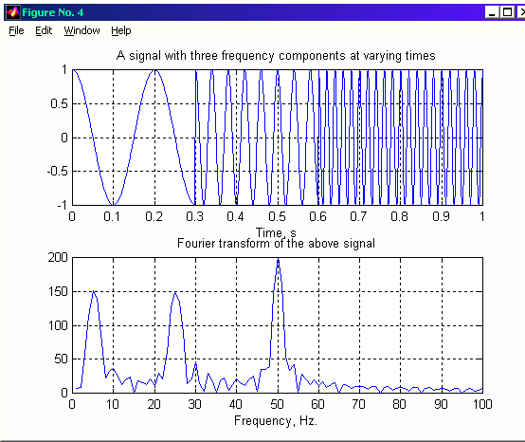

Stationary and Non-stationary Signals
Stationary signals’ spectral characteristics do not change with time
Non-stationary signals have time varying spectra
Concatenation

Slide 8
Non-stationary Signals
5 Hz
25 Hz
50 Hz
Perfect knowledge of what
frequencies exist, but no
information about where
these frequencies are
located in time

Slide 9
FT Shortcomings
Complex exponentials stretch out to infinity in time
  They analyze the signal globally, not locally
  Hence, FT can only tell what frequencies exist in the entire signal, but cannot tell, at what time instances these frequencies occur
  In order to obtain time localization of the spectral components, the signal need to be analyzed locally
  HOW ?

Slide 10
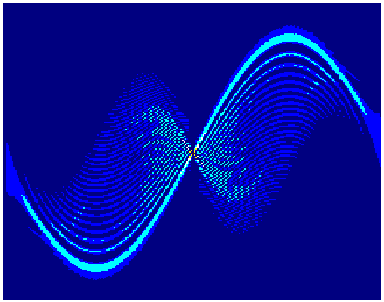
Time-Frequency Analysis
We want to analyze signals with time-varying frequencies;
Gabor Transform, Spectrogram, and Wigner-Ville distributions are the most used techniques.
Auger, Flandrin, Goncalves, Lemoine, "Time-Frequency Toolbox for Use with Matlab"
http://www.nongnu.org/tftb/tutorial.pdf

Slide 11
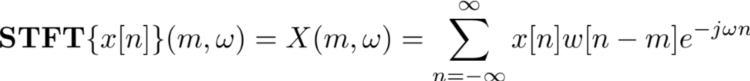
Short Time Fourier Transform (STFT)
Choose a window function of finite length
Put the window on top of the signal at t=0
Truncate the signal using this window
Compute the FT of the truncated signal, save.
Slide the window to the right by a small amount
Go to step 3, until window reaches the end of the signal
For each time location where the window is centered, we obtain a different FT
  Hence, each FT provides the spectral information of a separate time-slice of the signal, providing simultaneous time and frequency information

Slide 12
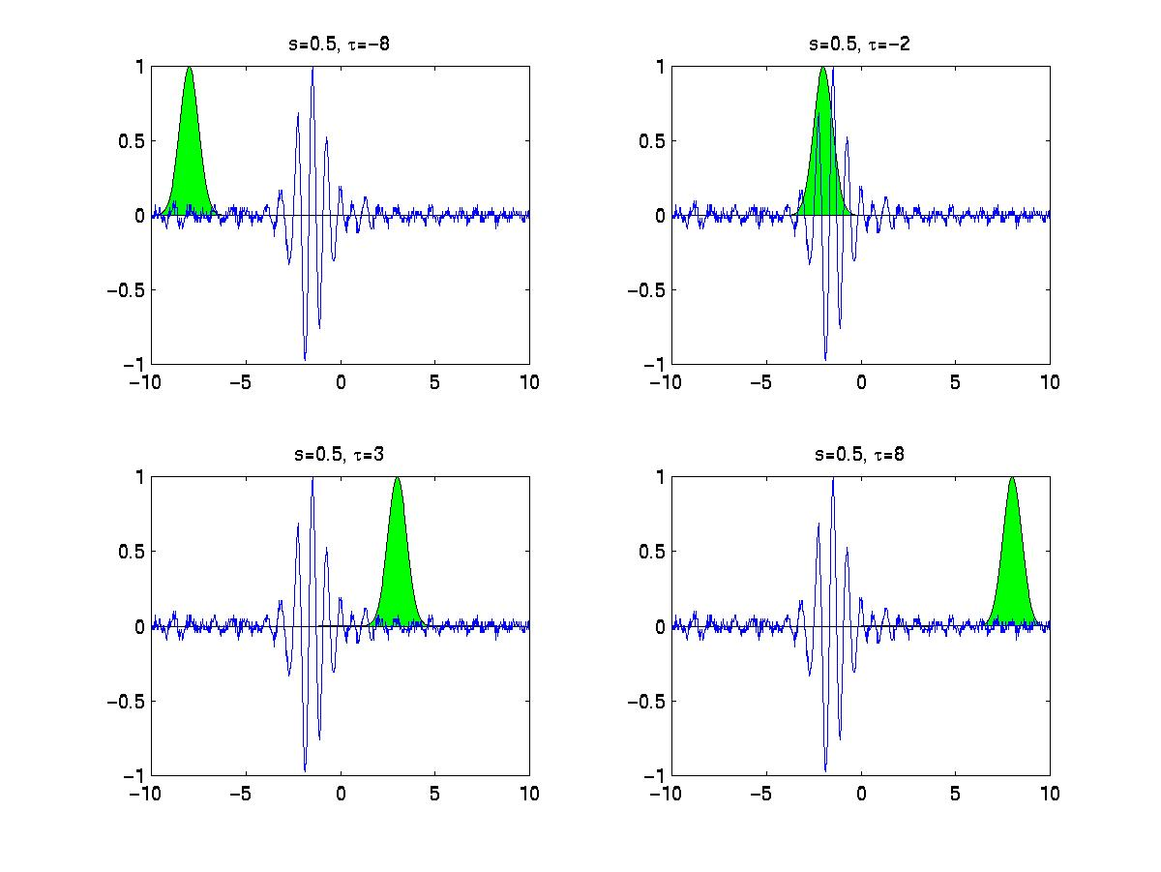
STFT

Slide 13

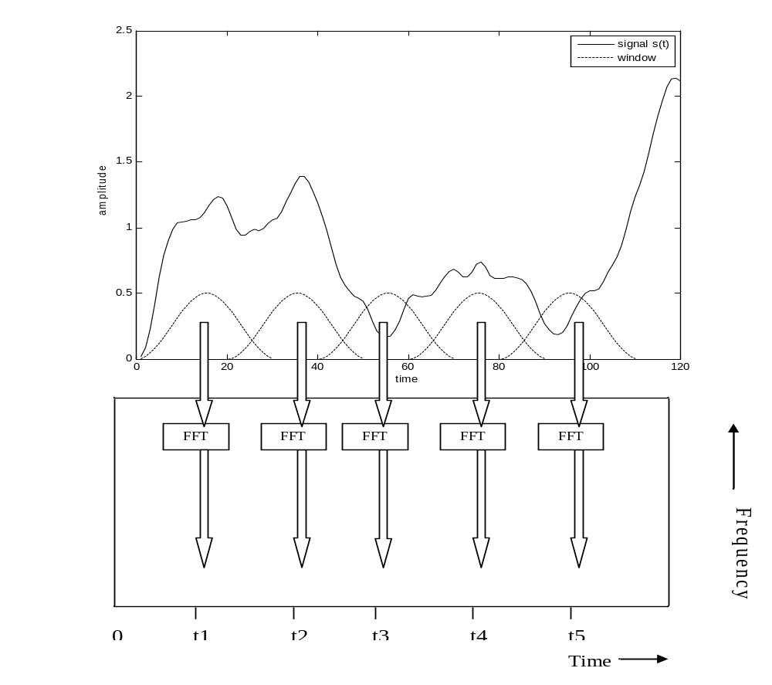

Slide 15
Properties of STFT
Linear
Complex valued
Time invariant
Time shift
Frequency shift
Many other properties of the FT also apply.

Slide 16
Time-Frequency Analysis- Spectrogram
Spectrogram
Computed through Fourier transforms on sections of the received signal;
Time-frequency resolution trade-off required;

Slide 17
Time-Frequency Analysis- Spectrogram
Spectrogram
Wideband
The width of the windowing function determines frequency and time resolutions.
A narrower window gives good time resolution but poor frequency resolution.
A wide window gives better frequency resolution but poor time resolution.
frequency
time
frequency
time
Narrowband

Slide 18
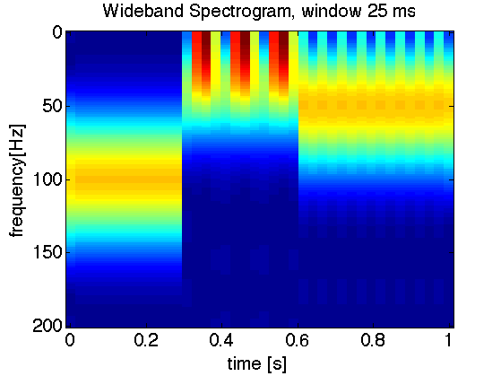
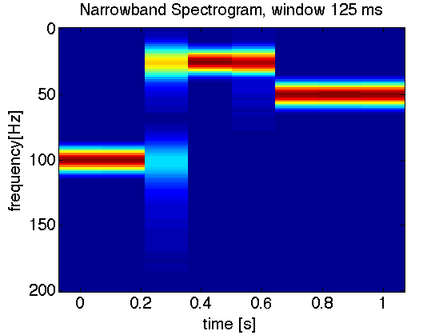
Time-Frequency Analysis- Spectrogram
Three tones (100, 25, 50 Hz), starting in 3 different instants (0, 0.3 and 0.6 seconds)
The wideband spectrogram gives good information about time but poor about frequency;
The narrowband gives good information in frequency but the exact start time of the components is blurred;

Slide 19
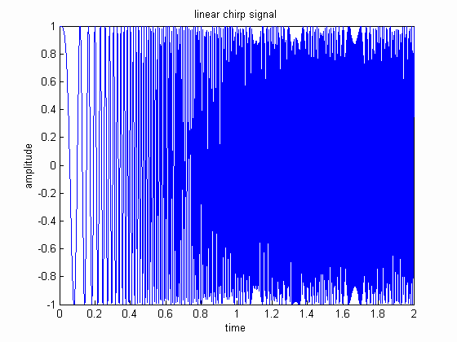

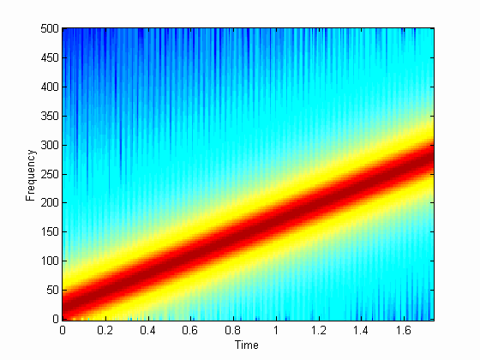
LFM – CHIRP

Slide 20
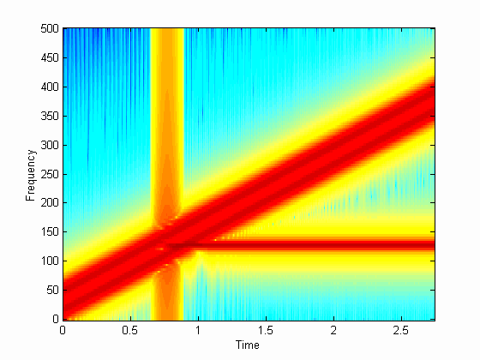
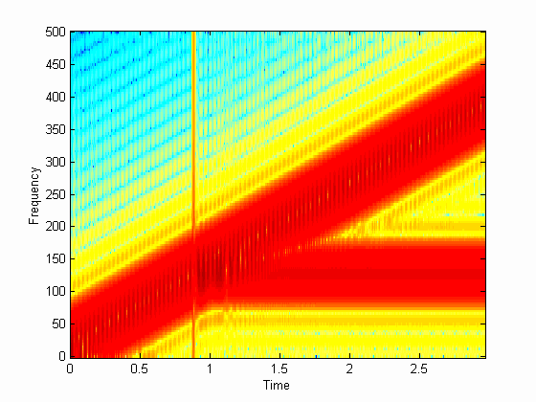
Large Window
(Narrowband)
Small Window
(Wideband)
In MATLAB you can use the function SPECTROGRAM to generate the above plots

Slide 21
Worked Example
We want to analyse a signal with a sampling frequency of 20kHz using a Spectrogram.
We want to use both a wideband and a narrowband spectrogram.
What is the window size (in samples) required in the wideband spectrogram to be able to resolve the signal with periodicity period of 7ms?
What is the window size (in samples) required in the narroband spectrogram to be able to resolve in the frequency domain with a resolution of 50Hz ?

Slide 22
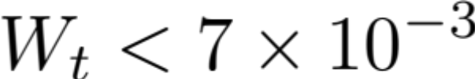
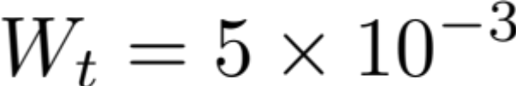
Worked Example - Solution
In the wideband spectorgram the window duration in time must be less than the period that we want to resolve:
So we can select
In samples it becomes:
seconds
seconds

Slide 23
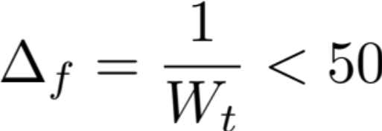
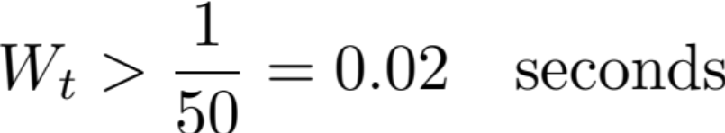

Worked Example - Solution
In the narroband spectorgram the window duration in time must be long enough to have a frequency resolution of less than 50 Hz:
Meaning that
We can select
In samples:
Hz

Slide 24
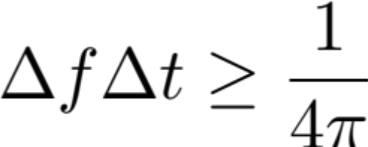
Gabor Uncertainty Principle
Time Domain
Frequency Domain

Slide 25
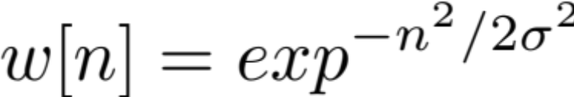
Gabor Transform
The only case in which:
Occurs when a Gaussian window is used:
A Short Time –Fourier Transform that uses Gaussian windows is also called Gabor Transform.

Slide 26
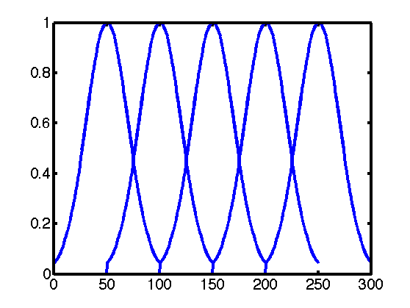
Overlap
Windows are useful to reduce spectral leakage;
However some information can be lost due to the transition and the weighting
Applying overlap reduces the information loss;
The drawback is higher computational cost.

Slide 28
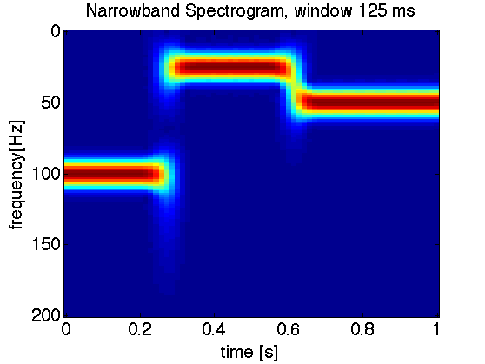
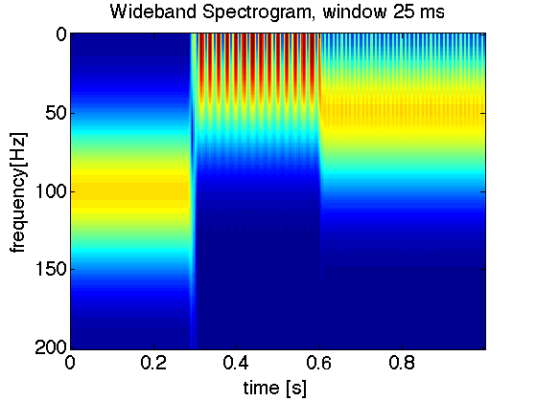
Overlap
With Overlap

Slide 29
Energy Distributions

Slide 30

Energy Distributions
STFT like transform decompose the signal in atoms, so they are also known as “atomic” distributions;
Distributions whose aim is to distribute the signal’s energy over time and frequency variables are called “energy” distributions;
The basic idea is to compute the joint time-frequency energy density of the signal such that:
Where is the energy of the signal

Slide 31
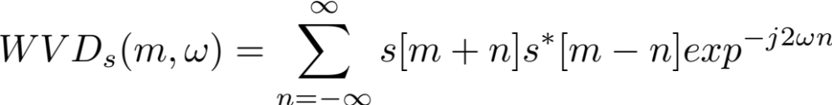
Wigner-Ville Distribution
Belongs to the class of energy distributions, in particular to the family of energy distributions that shares the time-frequency covariant property (time and frequency shifts of the signal maps on the TFD);
It is the Fourier transform of the auto-correlation function:
High time and frequency resolution achievable (sample scale);

Slide 32
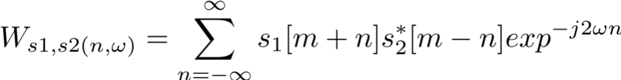
Wigner-Ville Distribution
As the WVD is a biliniar function, the quadratic superposition princple applies:
where
is the cross-WVD.
So the WVD suffers of non-zero interference terms (cross-terms) that can affect the correct identification of the real signal components

Slide 33
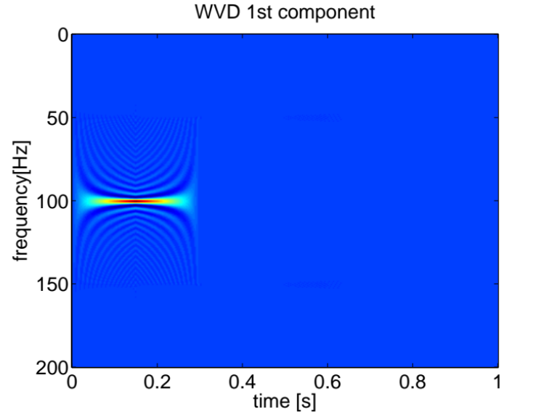
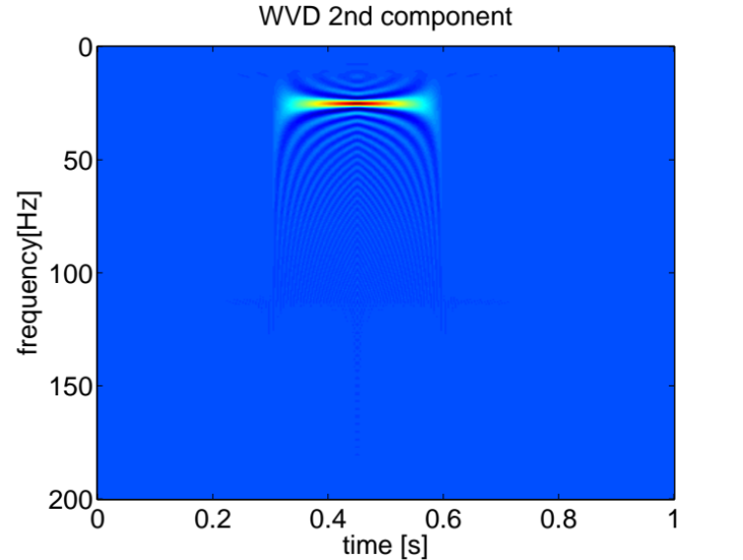
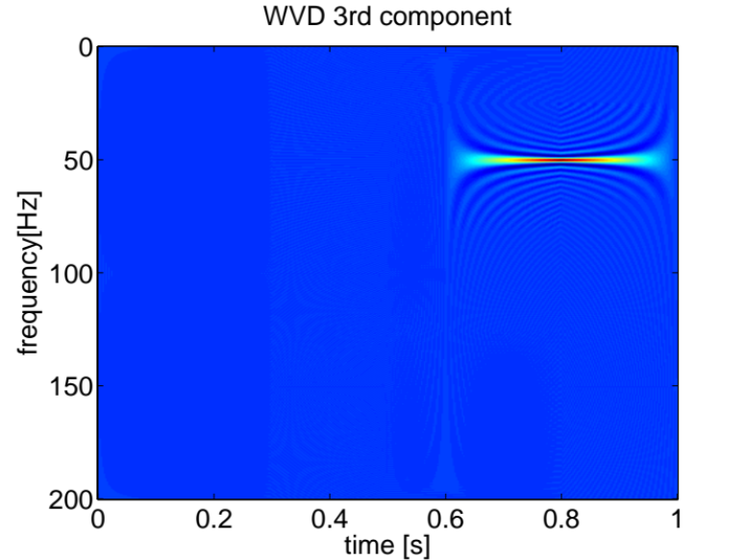
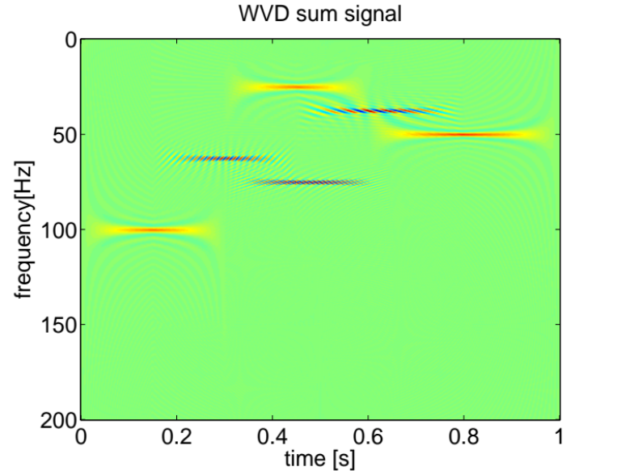
Wigner-Ville Distribution

Slide 34

Pseudo and Smoothed Pseudo Wigner-Ville Distributions
By applying time and frequency windowing the inteference effect can be mitigated:
These are known as Pseudo Wigner-Ville Distribution and Smoothed-Pseudo Wigner-Ville Distribution.

Slide 35

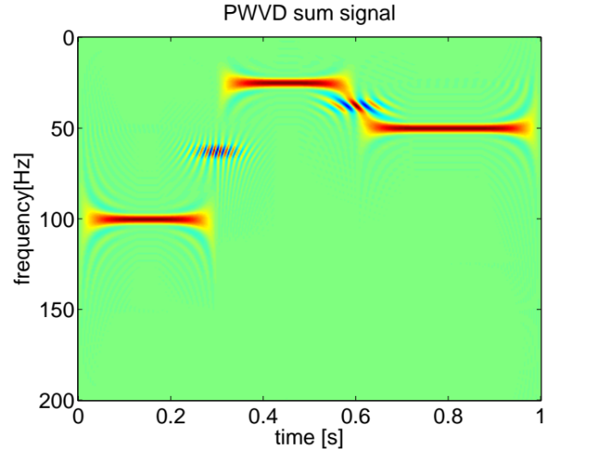
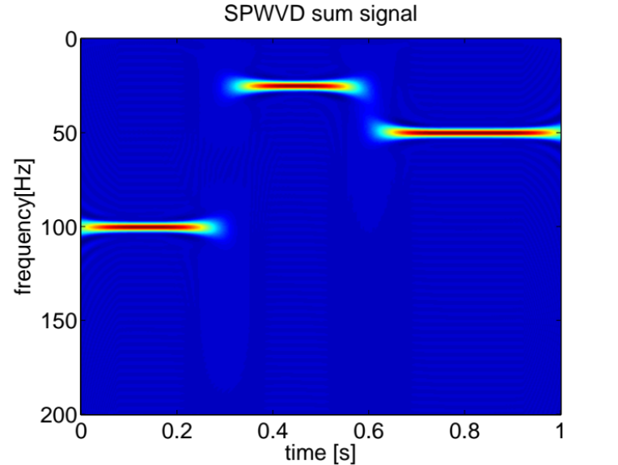
Pseudo and Smoothed Pseudo Wigner-Ville Distributions

Slide 36
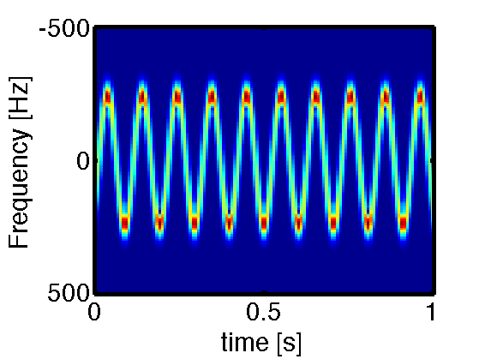
Detecting periodicity in the frequency domain

Slide 37

Cepstrum
Cepstral signal analysis is one out of several methods that enables us to find out whether a signal contains periodic elements.
The method can also be used to determine the pitch of a signal.
The cepstral coefficients are found by using the following equation
The variable is called quefrency.

Slide 38
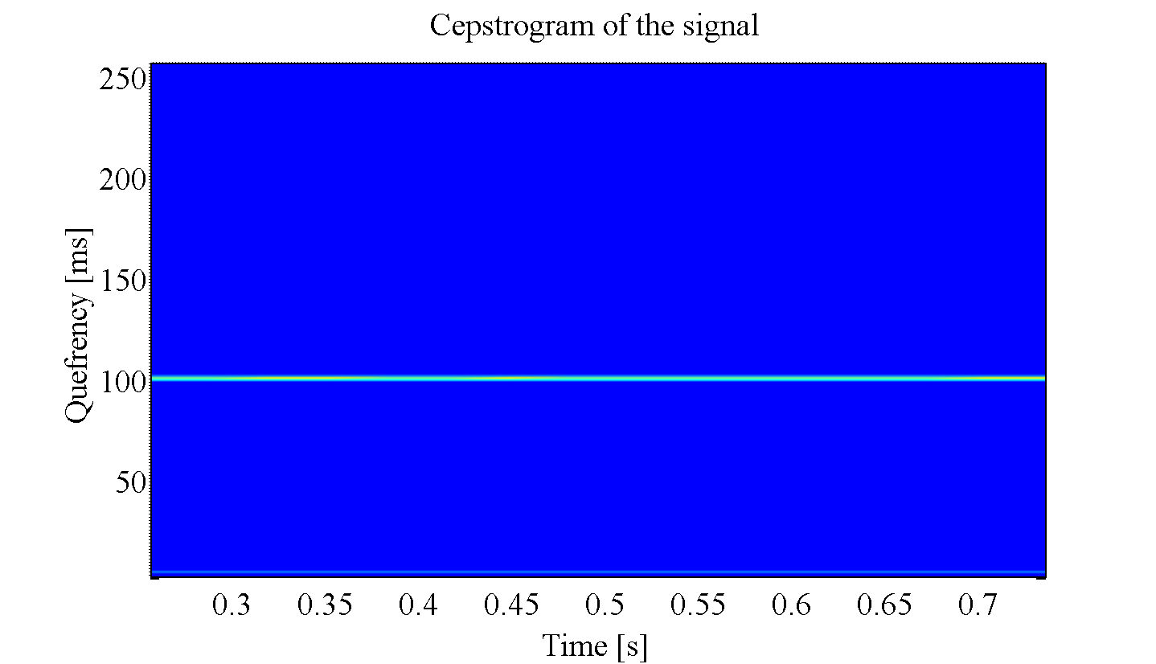
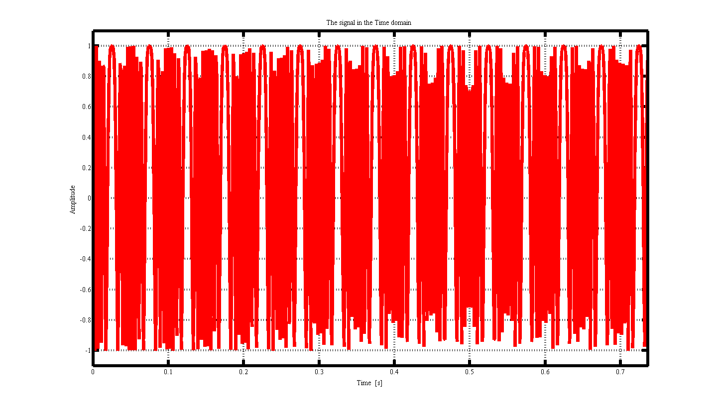
Cepstrogram
Applying the cepstrum to a spectrogram a CEPSTROGRAM is obtained

Slide 39
Homework – Not Compulsory
Download on your phone a spectrogram app:
  Android
    https://play.google.com/store/apps/details?id=net.galmiza.android.spectrogram&hl=it
  IOS
    https://apps.apple.com/us/app/spectrumview/id472662922
Familiarize with the app and its options and try to analyse your own speech, music, environmental noise, varying the offered parameters.

